Slide 1
Certified Ethical Hacker
Certification Prep Day 3

Slide 2
Class Objectives
By the end of class today, students will be able to:
Articulate email networking concepts and security issues
Use Nmap to perform host discovery and service scans
Categorize malware based on infection methods and behavior
Answer questions on the aforementioned topics as they would appear on the Certified Ethical Hacker exam.

Slide 3
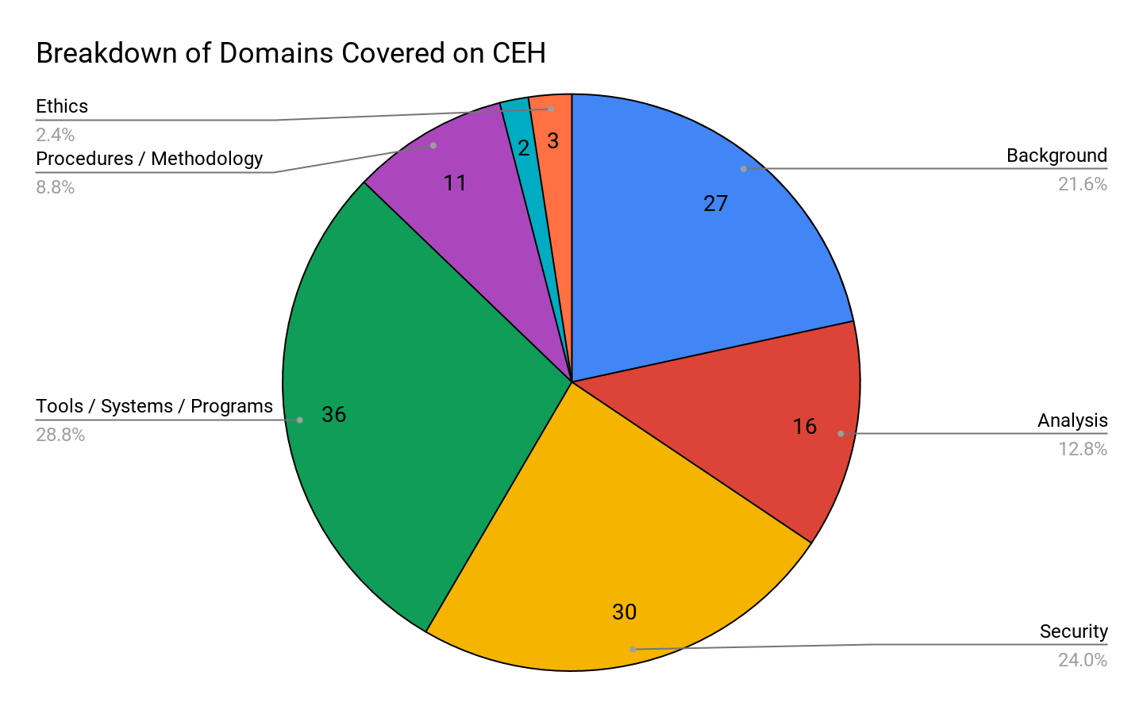
CEH Topics Breakdown
Background
Analysis / Assessment
Security
Tools/ Systems/ Programs
Procedures/ Methodology
Regulations / Policy
Ethics

Slide 4
Activity: Warm-Up Quiz
In this activity, you will work on a quiz that covers topics from each domain that we will cover in today’s lesson.
Instructions sent via Slack.
10 Minutes

Slide 5
Warm-Up Quiz

Slide 6
Warm-Up Review
1. What is the program that would monitor every keystroke that the victim enters?
Sniffer
Virus
Keylogger
Smurf

Slide 7
Warm-Up Review
1. What is the program that would monitor every keystroke that the victim enters?
Sniffer
Virus
Keylogger
Smurf

Slide 8
Warm-Up Review
2. What is a worm? Choose the most correct definition:
It is a form of eavesdropping between two network devices, involving spoofed packets.
It’s a type of DoS attack used to gain access or shutdown remote servers by overflowing them with random packets.
It’s when malware is file-binded into applications or media files.
It’s a self-replicating form of malware.

Slide 9
Warm-Up Review
2. What is a worm? Choose the most correct definition:
It is a form of eavesdropping between two network devices, involving spoofed packets.
It’s a type of DoS attack used to gain access or shutdown remote servers by overflowing them with random packets.
It’s when malware is file-binded into applications or media files.
It’s a self-replicating form of malware.

Slide 10
Warm-Up Review
3. Which of the following is a software that steals and sends people’s private info?
Ransomware
Spyware
Worms
Zombies

Slide 11
Warm-Up Review
3. Which of the following is a software that steals and sends people’s private info?
Ransomware
Spyware
Worms
Zombies

Slide 12
Warm-Up Review
4. True or False: Trojans are so effective is because the hacker is able to change the signature and avoid detection.

Slide 13
Warm-Up Review
4. True or False: Trojans are so effective is because the hacker is able to change the signature and avoid detection.
TRUE

Slide 14
Warm-Up Review
5. Which of the following changes their signatures every time they replicate?
Ransomware
Spyware
Polymorphic Viruses
Zombies

Slide 15
Warm-Up Review
5. Which of the following changes their signatures every time they replicate?
Ransomware
Spyware
Polymorphic Viruses
Zombies

Slide 16
Warm-Up Review
6. In order to take control early in the boot process, some viruses reside in the:
Memory
Boot sector
Flash drive
Hard drive

Slide 17
Warm-Up Review
6. In order to take control early in the boot process, some viruses reside in the:
Memory
Boot sector
Flash drive
Hard drive

Slide 18
Warm-Up Review
7. Which of the following is not a type of malware?
Worms
Spyware
Ransomware
Bugs

Slide 19
Warm-Up Review
7. Which of the following is not a type of malware?
Worms
Spyware
Ransomware
Bugs

Slide 20
Warm-Up Review
8. Between viruses and worms, which are capable of spreading on their own, without the user having to interact with it?

Slide 21
Warm-Up Review
8. Between viruses and worms, which are capable of spreading on their own, without the user having to interact with it?
Worms

Slide 22
Warm-Up Review
9. Which of the following best describes a rootkit?
It’s malware that uses social engineering techniques.
It’s malware that intercepts packets in transit without being stored onto a target machine.
It’s malware that propagates without a specific target.
It’s a type of malware that is used to backdoor a target machine while attempting to remain hidden.

Slide 23
Warm-Up Review
9. Which of the following best describes a rootkit?
It’s malware that uses social engineering techniques.
It’s malware that intercepts packets in transit without being stored onto a target machine.
It’s malware that propagates without a specific target.
It’s a type of malware that is used to backdoor a target machine while attempting to remain hidden.

Slide 24
Warm-Up Review
10. Which of the following used to list all of the shared resources on a remote host?
Netstat
Net view
Network
Netcat

Slide 25
Warm-Up Review
10. Which of the following used to list all of the shared resources on a remote host?
Netstat
Net view
Network
Netcat

Slide 26
Warm-Up Review
11. What does SNMP stand for?
Sender Null Modulation Protocol
Service Net Modulation Protocol
Simple Network Management Protocol
Simplified Node Management Protocol

Slide 27
Warm-Up Review
11. What does SNMP stand for?
Sender Null Modulation Protocol
Service Net Modulation Protocol
Simple Network Management Protocol
Simplified Node Management Protocol

Slide 28
Warm-Up Review
12. Which argument will be used for OS detection in Nmap?
-G
-L
-S
-O

Slide 29
Warm-Up Review
12. Which argument will be used for OS detection in Nmap?
-G
-L
-S
-O

Slide 30
Warm-Up Review
13. A Null session is when someone connects with:
Username: admin, password:blank
Username: root, password: root
No username or password
Username: random , password: blank

Slide 31
Warm-Up Review
13. A Null session is when someone connects with:
Username: admin, password:blank
Username: root, password: root
No username or password
Username: random , password: blank

Slide 32
Warm-Up Review
14. What will the following nmap command accomplish?
NMAP -sS -O -p 123,153 192.168.100.4
A stealth scan, opening port 123 and 153
A stealth scan, determine the operating system and scanning of ports 123 and 153
A stealth scan checking all open ports excluding ports 123 and 153

Slide 33
Warm-Up Review
14. What will the following nmap command accomplish?
NMAP -sS -O -p 123,153 192.168.100.4
A stealth scan, opening port 123 and 153
A stealth scan, determine the operating system and scanning of ports 123 and 153
A stealth scan checking all open ports excluding ports 123 and 153

Slide 34
Warm-Up Review
15. What will the following nmap command accomplish?
NMAP -sS -O -p 123-153 192.168.100.4
A stealth scan, determine the operating system and scanning of ports 123 through 153
A TCP-connect scan, determine the operating system and scanning of ports 123 and 153
A stealth scan checking all open ports excluding ports 123 and 153
A SYN scan, opening ports 123 and 153

Slide 35
Warm-Up Review
15. What will the following nmap command accomplish?
NMAP -sS -O -p 123-153 192.168.100.4
A stealth scan, determine the operating system and scanning of ports 123 through 153
A TCP-connect scan, determine the operating system and scanning of ports 123 and 153
A stealth scan checking all open ports excluding ports 123 and 153
A SYN scan, opening ports 123 and 153

Slide 36
Warm-Up Review
16. What best describes banner grabbing?
It is used to map a web server.
It is used to remove banner ads from web pages.
It is used to acquire embedded scripting from web pages.
It is used to acquire HTML source code.

Slide 37
Warm-Up Review
16. What best describes banner grabbing?
It is used to map a web server.
It is used to remove banner ads from web pages.
It is used to acquire embedded scripting from web pages.
It is used to acquire HTML source code.

Slide 38
Warm-Up Review
17. An Nmap scan of a server shows port 25 is open. Which of the following describes the risk of leaving that port open?
Web portal data leak
Clear text authentication
Open printer sharing
Active mail relay

Slide 39
Warm-Up Review
17. An Nmap scan of a server shows port 25 is open. Which of the following describes the risk of leaving that port open?
Web portal data leak
Clear text authentication
Open printer sharing
Active mail relay

Slide 40
Warm-Up Review
18. Regarding port enumeration, which port does DNS zone transfer use?
UDP port 161
TCP / UDP port 389
TCP port 137
TCP port 53

Slide 41
Warm-Up Review
18. Regarding port enumeration, which port does DNS zone transfer use?
UDP port 161
TCP / UDP port 389
TCP port 137
TCP port 53

Slide 42
Warm-Up Review
19. Which of the following refers to “reverse-engineering” rules that are implemented on a firewall, based on the results of port scans?
Firewalking
Firewalling
Firechalking
Firescaling

Slide 43
Warm-Up Review
19. Which of the following refers to “reverse-engineering” rules that are implemented on a firewall, based on the results of port scans?
Firewalking
Firewalling
Firechalking
Firescaling

Slide 44
Warm-Up Review
20. You are sent to scan a remote host using nmap. Which of the following scan types is the best choice to gather the most information while minimizing the chance of detection?
TCP connect scan (-sT)
Xmas scan (-sX)
UDP scan (-sU)
SYN scan (-sS)

Slide 45
Warm-Up Review
20. You are sent to scan a remote host using nmap. Which of the following scan types is the best choice to gather the most information while minimizing the chance of detection?
TCP connect scan (-sT)
Xmas scan (-sX)
UDP scan (-sU)
SYN scan (-sS)

Slide 46
Warm-Up Review
21. You are asked to access a server at a particular IP address. The server does not respond to ping requests, what could be the reason? (Select all that apply)
The host is down.
Server configured not to respond to ping.
Firewall blocks TCP.
Firewall blocks ICMP.

Slide 47
Warm-Up Review
21. You are asked to access a server at a particular IP address. The server does not respond to ping requests, what could be the reason? (Select all that apply)
The host is down.
Server configured not to respond to ping.
Firewall blocks TCP.
Firewall blocks ICMP.

Slide 48
Warm-Up Review
22. Which command would you issue to scan all TCP ports on 192.168.1.1?
nmap -p 0, 65535 192.168.1.1
nmap -p 1,65536 192.168.1.1
nmap -p 192.168.1.1
nmap -p 0-65535 192.168.1.1

Slide 49
Warm-Up Review
22. Which command would you issue to scan all TCP ports on 192.168.1.1?
nmap -p 0, 65535 192.168.1.1
nmap -p 1,65536 192.168.1.1
nmap -p 192.168.1.1
nmap -p 0-65535 192.168.1.1

Slide 50
Warm-Up Review
23. Which of the following nmap arguments are used to perform a Null scan:
-sS
-sP
-sN
-sF

Slide 51
Warm-Up Review
23. Which of the following nmap arguments are used to perform a Null scan:
-sS
-sP
-sN
-sF

Slide 52
Warm-Up Review
24. Which argument would you use to perform a Fin Scan in nmap?
-SF
-fs
-sF
-FIN

Slide 53
Warm-Up Review
24. Which argument would you use to perform a Fin Scan in nmap?
-SF
-fs
-sF
-FIN

Slide 54
Warm-Up Review
25. Most scan attempts can be detected and flagged by:
Proxy
IDS
Router
Switch

Slide 55
Warm-Up Review
25. Most scan attempts can be detected and flagged by:
Proxy
IDS
Router
Switch

Slide 56
Warm-Up Review
26. Which of these scan types in nmap would make a full TCP connection to the target system?
XMAS scan
TCP connect scan
All of these
SYN stealth scan

Slide 57
Warm-Up Review
26. Which of these scan types in nmap would make a full TCP connection to the target system?
XMAS scan
TCP connect scan
All of these
SYN stealth scan

Slide 58
How Emails are Sent
‹#›

Slide 59





How Emails Work
Step 1: Bob uses Microsoft Outlook to type and send an email to Alice.
Bob, bob@bob.com, composes an email to Alice, at alice@alice.com.
Once Bob clicks Send, the email is forwarded to Bob’s company’s email server.
The email server is also referred to as the MTA (mail transfer agent).
To: Alice@alice.com
@
Bob@bob.com
Email Server
Alice@alice.com
‹#›

Slide 60
How Emails Work
Step 2: Bob’s mail server finds Alice’s mail server.
Bob's mail server does a DNS lookup against alice.com to determine its mail server.
Bob's mail server gets this information from alice.com's MX record.
Bob@bob.com
Email Server
Alice@alice.com
Looking for alice.com
‹#›

Slide 61
How Emails Work
Step 3: Bob's mail server forwards the email to Alice’s mail server.
Using SMTP (Simple Mail Transfer), Bob’s mail server sends the email to Alice’s mail server.
SMTP uses port 25 and is part of Layer 7: Application of the OSI model.
✓
@
Bob@bob.com
Email Server
Email Server
Alice@alice.com
‹#›
Alice@alice.com

Slide 62

How Emails Work
Step 4: Alice pulls Bob’s email onto her local computer to read it.
Two Layer 7 protocols can be used to transfer the email to Alice’s local computer.
POP3 (Post Office Protocol)
IMAP (Internet Message Access Protocol)
When Alice logs in and checks her email from Bob, the POP3 mailbox doesn't keep a copy of the email.
Alice would not be able to log into another computer to view Bob's email, as it already has been downloaded from the mail server.
POP3 has a security benefit, as the email will not exist on a server the recipient doesn't control.
A copy of the email is kept on the server.
Even after Alice logs in and check her email from Bob, she can check it again from another computer.
IMAP has the benefit of preventing data from being lost, as it backs up emails on a server.
‹#›

Slide 63
To complete the previous steps, emails use headers made up of specific fields.
‹#›

Slide 64
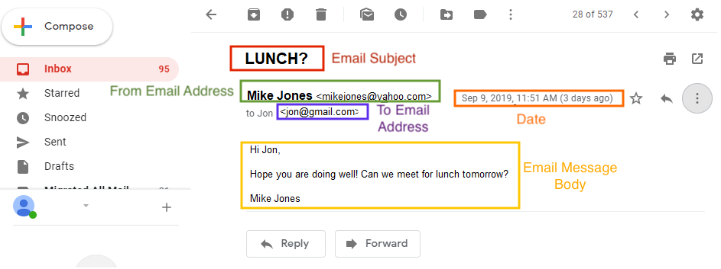
Familiar Fields
If you’ve ever sent an email, you’re probably familiar with the following fields:
‹#›

Slide 65
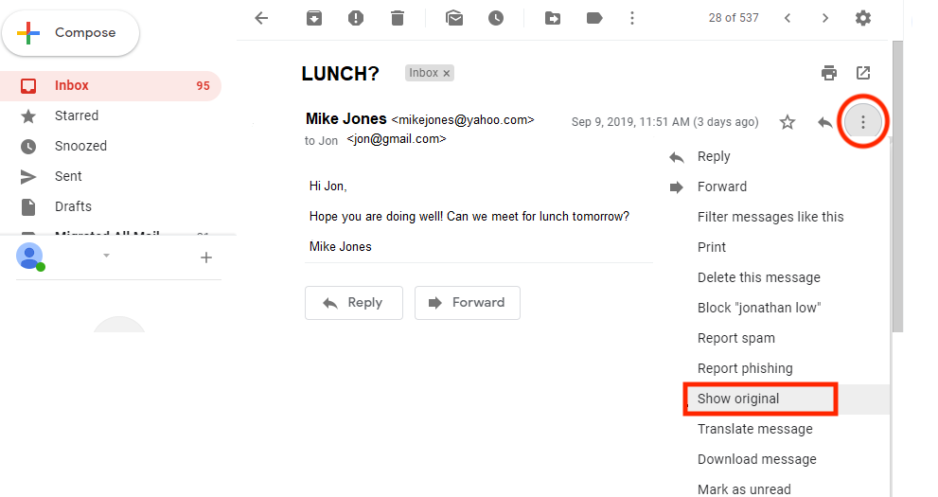
Unfamiliar Fields
More fields are revealed by viewing the complete raw email:
‹#›

Slide 66
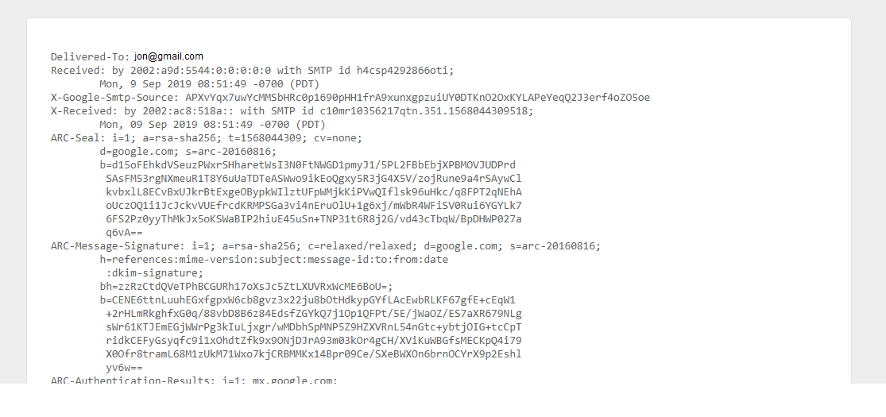
Unfamiliar Fields
The raw email will reveal other fields:
Return-Path: Specifies the sender's return email.
‹#›

Slide 67
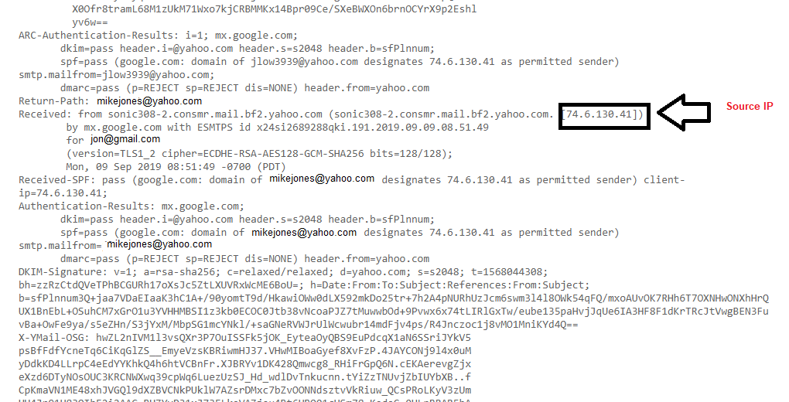
Un-Familiar Fields
Received: Shows a list of the mail servers, illustrating the path of the email from source to destination.
‹#›

Slide 68
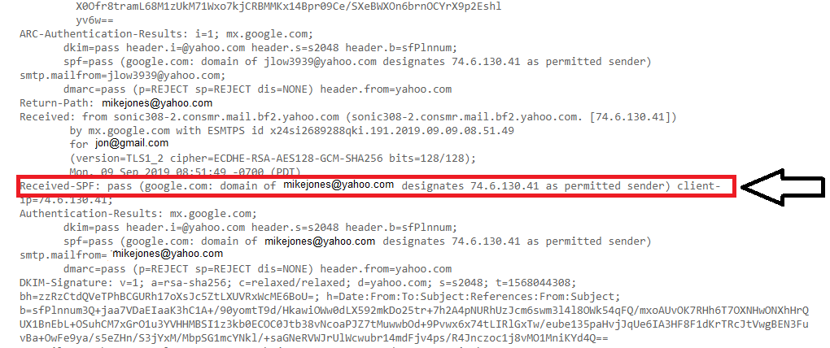
Unfamiliar Fields
Message-ID: Unique string created by the sending mail server as an identifier of the email.
Received SPF: The SPF verification field.
‹#›

Slide 69
Activity: Email Networking
In this activity, you will continue to play the role of a security analyst for Acme Corp.
Your task is to analyze the header records of suspicious emails and document several data points.
15 minutes
‹#›

Slide 72
Scanning with Nmap

Slide 73
Host Discovery
After identifying the network range that their target belongs to, attackers typically scan it for other live hosts.
For the CEH exam, you should be familiar with the following methods of host discovery:
ARP Discovery: Sends ARP requests out for every IP address in the target range. Only live hosts will respond.
Ping Sweep: Sends a ping request to every IP address in the target range. Only live hosts will respond.

Slide 74
What process comes after host discovery?

Slide 75
Port Scanning
Port scanning is the process of attempting to connect every port on a target machine and keeping track of which connection attempts are successful.
What tool do we use for port scanning?

Slide 76
Port Scanning
Port scanning is the process of attempting to connect every port on a target machine and keeping track of which connection attempts are successful.
What tool do we use for port scanning?
Nmap is the most important tool for scanning ports.
SYN Scan is the default scan type.
Nmap sends TCP flags to a target port with the SYN flag set.
If the target is open, it responds with a packet using the SYN/ACK flag set.
Then, nmap does not respond, leaving the target port in a half-open state.

Slide 77
Port Scanning
What do the following commands do?
nmap -sS -p 445 192.168.12.50:
nmap -sT -p 445 192.168.12.50:
nmap -sU -p 53 192.168.12.50:
nmap -sS -p U:53,T:53 192.168.12.50:

Slide 78
Port Scanning
What do the following commands do?
nmap -sS -p 445 192.168.12.50:
Performs a SYN scan against port 445 on 192.169.12.50.
nmap -sT -p 445 192.168.12.50:
nmap -sU -p 53 192.168.12.50:
nmap -sS -p U:53,T:53 192.168.12.50:

Slide 79
Port Scanning
What do the following commands do?
nmap -sS -p 445 192.168.12.50:
Performs a SYN scan against port 445 on 192.169.12.50.
nmap -sT -p 445 192.168.12.50:
Performs a TCP Connect scan against port 445 on 192.169.12.50.
nmap -sU -p 53 192.168.12.50:
nmap -sS -p U:53,T:53 192.168.12.50:

Slide 80
Port Scanning
What do the following commands do?
nmap -sS -p 445 192.168.12.50:
Performs a SYN scan against port 445 on 192.169.12.50.
nmap -sT -p 445 192.168.12.50:
Performs a TCP Connect scan against port 445 on 192.169.12.50.
nmap -sU -p 53 192.168.12.50:
Performs a UDP scan of port 53 on 192.168.12.50.
nmap -sS -p U:53,T:53 192.168.12.50:

Slide 81
Port Scanning
What do the following commands do?
nmap -sS -p 445 192.168.12.50:
Performs a SYN scan against port 445 on 192.169.12.50.
nmap -sT -p 445 192.168.12.50:
Performs a TCP Connect scan against port 445 on 192.169.12.50.
nmap -sU -p 53 192.168.12.50:
Performs a UDP scan of port 53 on 192.168.12.50.
nmap -sS -p U:53,T:53 192.168.12.50:
Scans UDP port 53 and TCP port 53. Use a SYN scan on the TCP port.

Slide 82
What process comes after port scanning?

Slide 83
OS and Service Fingerprinting
After identifying open ports on a target machine, the next step is to determine which operating system is running on each target and which services are running on each open port.
The following Nmap flags allow you to profile both operating systems and services.
-sV flag enables service version detection.
Nmap not only determines if a target port is open, but also determines which services are running on that port.
-O enables passive OS detection.
Determines the target machine’s operating system based only on the data it collects during a normal port scan.
-A flag enables active OS detection.
Sends additional packets meant specifically to elicit responses revealing the target’s OS.

Slide 84
OS and Service Fingerprinting
What do the following commands do?
nmap -sV -p 80, 443 192.168.12.50
nmap -0 -sV -p 80, 443 192.168.12.50
nmap -A -sV -p 80, 443 192.168.12.50

Slide 85
OS and Service Fingerprinting
What do the following commands do?
nmap -sV -p 80, 443 192.168.12.50
Performs a service scan of ports 80 and 443 on 192.168.12.50. Does not determine the OS.
nmap -0 -sV -p 80, 443 192.168.12.50
nmap -A -sV -p 80, 443 192.168.12.50

Slide 86
OS and Service Fingerprinting
What do the following commands do?
nmap -sV -p 80, 443 192.168.12.50
Performs a service scan of ports 80 and 443 on 192.168.12.50. Does not determine the OS.
nmap -0 -sV -p 80, 443 192.168.12.50
Performs a service scan of ports 80 and 443 on 192.168.12.50 and determines the OS through passive methods.
nmap -A -sV -p 80, 443 192.168.12.50

Slide 87
OS and Service Fingerprinting
What do the following commands do?
nmap -sV -p 80, 443 192.168.12.50
Performs a service scan of ports 80 and 443 on 192.168.12.50. Does not determine the OS.
nmap -0 -sV -p 80, 443 192.168.12.50
Performs a service scan of ports 80 and 443 on 192.168.12.50 and determines the OS through passive methods.
nmap -A -sV -p 80, 443 192.168.12.50
Performs a service scan of ports 80 and 443 on 192.168.12.50 and determines the OS through active methods.

Slide 88
What’s next after OS and Service Fingerprinting?

Slide 89
Networking Mapping
Networking mapping is the process of collecting all the information gathering into a single document (a network map).
There are tools for generating graphical network maps, such as Maltego.
Hand-drawn maps should work just as well.
Creating maps helps clarify attack tactics and provides a good opportunity to synthesize all the information collected during the intelligence gathering phase.

Slide 90
Your Turn: Footprinting, Scanning and Enumeration Problem Set
In this activity, you will answer questions on the Scanning and Enumeration sections of the CEH exam.
Instructions sent via Slack.
20 Minutes

Slide 91
Scanning and Enumeration Problem Set

Slide 92
Footprinting, Scanning and Enumeration
1. What does the Nmap -sU flag do?
Enables TCP scanning
Enables UDP scanning
Enables Service Scanning
Banner-grabs all ports on the target

Slide 93
Footprinting, Scanning and Enumeration
1. What does the Nmap -sU flag do?
Enables TCP scanning
Enables UDP scanning
Enables Service Scanning
Banner-grabs all ports on the target

Slide 94
Footprinting, Scanning and Enumeration
2. Which of the following is not part of the information gathering phase?
Host Discovery
Finding Physical Addresses
Spidering the Clients Website
Exploiting a Database Server

Slide 95
Footprinting, Scanning and Enumeration
2. Which of the following is not part of the information gathering phase?
Host Discovery
Finding Physical Addresses
Spidering the Clients Website
Exploiting a Database Server

Slide 96
Footprinting, Scanning and Enumeration
3. Which of the following is also known as a Zombie scan?
SYN Scan
IDLE Scan
UDP Scan
Full-Connect Scan

Slide 97
Footprinting, Scanning and Enumeration
3. Which of the following is also known as a Zombie scan?
SYN Scan
IDLE Scan
UDP Scan
Full-Connect Scan

Slide 98
Footprinting, Scanning and Enumeration
4. Which of the following commands scans both TCP and UDP port 445?
nmap -sT -sU -p 445 192.168.12.75
nmap -p U:445,T:445 192.168.12.75
nmap -sU 445 -pT 192.168.12.75
nmap -sS --all-protocols 192.168.12.75

Slide 99
Footprinting, Scanning and Enumeration
4. Which of the following commands scans both TCP and UDP port 445?
nmap -sT -sU -p 445 192.168.12.75
nmap -p U:445,T:445 192.168.12.75
nmap -sU 445 -pT 192.168.12.75
nmap -sS --all-protocols 192.168.12.75

Slide 100
Footprinting, Scanning and Enumeration
5. Suppose you discover the following IP addresses on a target network: 192.168.1.24 and 192.168.1.35. Both machines have a netmask of 255.255.255.0. Which of the following is true?
The machines are on the same subnet.
The machines are on separate subnets.
The machines are unreachable from one another.
Neither machine is running Windows.

Slide 101
Footprinting, Scanning and Enumeration
5. Suppose you discover the following IP addresses on a target network: 192.168.1.24 and 192.168.1.35. Both machines have a netmask of 255.255.255.0. Which of the following is true?
The machines are on the same subnet.
The machines are on separate subnets.
The machines are unreachable from one another.
Neither machine is running Windows.

Slide 102
Footprinting, Scanning and Enumeration
6. Which of the following scan types is used to infer firewall rules?
Full Connect Scan
ACK Scan
SYN Scan
IDLE Scan

Slide 103
Footprinting, Scanning and Enumeration
6. Which of the following scan types is used to infer firewall rules?
Full Connect Scan
ACK Scan
SYN Scan
IDLE Scan

Slide 104
Footprinting, Scanning and Enumeration
7. Suppose you find ports 137, 138, and 139 open on a target machine. Which OS is it probably running?
Kali
Solaris
Ubuntu
Windows

Slide 105
Footprinting, Scanning and Enumeration
7. Suppose you find ports 137, 138, and 139 open on a target machine. Which OS is it probably running?
Kali
Solaris
Ubuntu
Windows

Slide 106
Footprinting, Scanning and Enumeration
8. Which of the following is commonly used for enumeration?
Hyena
John
IAM Tool
LCP

Slide 107
Footprinting, Scanning and Enumeration
8. Which of the following is commonly used for enumeration?
Hyena
John
IAM Tool
LCP

Slide 108
Footprinting, Scanning and Enumeration
9. Which of the following hash types are you most likely to encounter when enumerating password hashes on a Windows machine?
NTLMv2
SHA512-Crypt
BlowFish
ElGamal

Slide 109
Footprinting, Scanning and Enumeration
9. Which of the following hash types are you most likely to encounter when enumerating password hashes on a Windows machine?
NTLMv2
SHA512-Crypt
BlowFish
ElGamal

Slide 110
Footprinting, Scanning and Enumeration
10. Which of the following protocols can be used to enumerate usernames?
Check all that apply.
SMTP
SMB
DNS
IRC

Slide 111
Footprinting, Scanning and Enumeration
10. Which of the following protocols can be used to enumerate usernames?
Check all that apply.
SMTP
SMB
DNS
IRC

Slide 112
Footprinting, Scanning and Enumeration
11. Which of the following is a potential result of user enumeration?
Check all that apply.
Brute-Force Attacks
Pass the Hash
Horizontal Escalation / Lateral Movement
DoS

Slide 113
Footprinting, Scanning and Enumeration
11. Which of the following is a potential result of user enumeration?
Check all that apply.
Brute-Force Attacks
Pass the Hash
Horizontal Escalation / Lateral Movement
DoS

Slide 114
Footprinting, Scanning and Enumeration
12. Which of the following tools would you use to scan a target for vulnerabilities?
Check all that apply.
tcpdump
Nessus
Nmap
Metasploit

Slide 115
Footprinting, Scanning and Enumeration
12. Which of the following tools would you use to scan a target for vulnerabilities?
Check all that apply.
tcpdump
Nessus
Nmap
Metasploit

Slide 116
Footprinting, Scanning and Enumeration
13. Which tool would you use to enumerate SMB users on a WIndows target from a Kali Linux machine?
net
enum4linux
smbmap
dig

Slide 117
Footprinting, Scanning and Enumeration
13. Which tool would you use to enumerate SMB users on a WIndows target from a Kali Linux machine?
net
enum4linux
smbmap
dig

Slide 118
Footprinting, Scanning and Enumeration
14. Suppose you dump a Linux machine’s /etc/passwd file during the information gathering phase. You see the lines /bin/nlogin and /bin/false for many users.
What does this mean?
The user doesn’t exist.
These users exist, but aren’t stored in the database.
These users exist, but can’t use an interactive shell.
These users exist, but their accounts have been disabled.

Slide 119
Footprinting, Scanning and Enumeration
14. Suppose you dump a Linux machine’s /etc/passwd file during the information gathering phase. You see the lines /bin/nlogin and /bin/false for many users.
What does this mean?
The user doesn’t exist.
These users exist, but aren’t stored in the database.
These users exist, but can’t use an interactive shell.
These users exist, but their accounts have been disabled.

Slide 120
Footprinting, Scanning and Enumeration
15. Suppose you attempt to enumerate users on the website www.foosports.com. You’re able to send 5 requests upon launching the attack, but stop receiving responses after that. What most likely happened?
The attack failed because the site doesn’t have enough users to enumerate.
The target server blocked your IP address.
Your scan crashed the target server.
Your router no longer recognized the target IP address.

Slide 121
Footprinting, Scanning and Enumeration
15. Suppose you attempt to enumerate users on the website www.foosports.com. You’re able to send 5 requests upon launching the attack, but stop receiving responses after that. What most likely happened?
The attack failed because the site doesn’t have enough users to enumerate.
The target server blocked your IP address.
Your scan crashed the target server.
Your router no longer recognized the target IP address.

Slide 122
Footprinting, Scanning and Enumeration
16. Identify one advantage of an IDLE scan.
They allow an attacker to get information about a target’s open ports without actually sending packets.
They allow an attacker to scan a target without revealing their IP address.
They are undetectable.
They can find all open ports on a machine, including those that are filtered by a firewall.

Slide 123
Footprinting, Scanning and Enumeration
16. Identify one advantage of an IDLE scan.
They allow an attacker to get information about a target’s open ports without actually sending packets.
They allow an attacker to scan a target without revealing their IP address.
They are undetectable.
They can find all open ports on a machine, including those that are filtered by a firewall.

Slide 124
Footprinting, Scanning and Enumeration
17. Identify two disadvantage of an IDLE scan.
They require more machines than a SYN scan.
They are unreliable.
They rarely work.
They are slow.

Slide 125
Footprinting, Scanning and Enumeration
17. Identify two disadvantage of an IDLE scan.
They require more machines than a SYN scan.
They are unreliable.
They rarely work.
They are slow.

Slide 126
Footprinting, Scanning and Enumeration
18. Which of the following tools allows you to enumerate URLs? Check all that apply.
Burp Suite
dirb
wfuzz
kismet

Slide 127
Footprinting, Scanning and Enumeration
18. Which of the following tools allows you to enumerate URLs? Check all that apply.
Burp Suite
dirb
wfuzz
kismet

Slide 128
Footprinting, Scanning and Enumeration
19. Which of the following tools is used for wireless attacks and enumeration?
kismet
PowerShell
zsh
ZAP Proxy

Slide 129
Footprinting, Scanning and Enumeration
19. Which of the following tools is used for wireless attacks and enumeration?
kismet
PowerShell
zsh
ZAP Proxy

Slide 130
Footprinting, Scanning and Enumeration
20. Which of the following commands runs all of Nmap’s SMB scripts against a target?
nmap --smb-all -sV -p 445 192.168.12.17
nmap --script --smb-scripts 192.168.12.17
nmap --script smb-enum-* -sV -p 445 192.168.12.17
nmap --script smb-enum-* 192.168.12.17

Slide 131
Footprinting, Scanning and Enumeration
20. Which of the following commands runs all of Nmap’s SMB scripts against a target?
nmap --smb-all -sV -p 445 192.168.12.17
nmap --script --smb-scripts 192.168.12.17
nmap --script smb-enum-* -sV -p 445 192.168.12.17
nmap --script smb-enum-* 192.168.12.17

Slide 132
Malware & Passwords

Slide 133
Malware & Passwords
Many of the vulnerabilities discovered by Nmap can be exploited with malware.
One of the most common tasks that malware performs is finding and dumping passwords from a target machine.
CEH tests on the basic understanding of malware and password attacks, such as:
Types of Malware and Infection Methods
Windows Password Hash Format
Linux Password Hash Formats

Slide 134
Malware Types
The most important types of malware:
Virus: Malware that requires human interaction to run and spread. Hackers often spread viruses by tricking users into downloading and executing them, as in phishing attacks.
Trojan: Malware that "poses" as legitimate software. For example, a hacker might send a phishing email with an attachment called WindowsUpdate.exe, which actually contains malware.
Worm: Malware that can spread without human interaction, making them especially dangerous.

Slide 135
Malware Types
Viruses, trojans and worms can infect the following parts of a computer:
Boot Record: Viruses that infect the code that computers use to boot up. These are extremely dangerous viruses, as they are difficulty to detect.
File Infection: Infect normal files, such as PNG images.
Macro Infection: Viruses embedded in Word or Excel macros. This is commonly used to spread malware through phishing attacks.
Polymorphic: Changes its code every time it infects a new computer. This makes them very hard to detect.
Multipart: A multipart virus is one that can infect multiple parts of a computer, such as both the boot records and the file system.

Slide 136
Malware Phases
Regardless of type or result, all malware spreads through five phases:
Search Routine: The virus is downloaded onto the target and begins looking for a place to infect.
Infection Routine: The virus actually infects its target. The virus payload does not necessarily run. It just embeds itself into the target and lies dormant until it receives a command to run.
Trigger Routine: The virus executes and actually delivers its payload.
Anti-Detection Routine: Some sophisticated viruses can hide themselves from anti-virus software. Those that do are said to have an "anti-detection routine".

Slide 137
Honeypots
A machine tailor-made for catching real malware is called a honey pot.
Researchers often study malware by "tricking" attackers into hacking "dummy" machines that they control, collecting the malware the attacker plants on the device, and studying its actions and effects.
All secure networks should have at least one honeypot, so administrators and security analysts can keep track of which kinds of malicious software is entering their network.

Slide 138
Windows Passwords Hash Types
Remember: Operating systems store passwords in hashes, so if hackers can’t retrieve the cleartext passwords if they dump the hashes.
Window Password Hash Types include:
LM
NTHash
NTLM

Slide 139
Windows Passwords Hash Types
LM
LM is a weak hash type used before Windows Vista/Windows Server 2008.
LM hashes are rarely used today, but sometimes appear in legacy networks.
LM hashes look like: 299BD128C1101FD6
Cracking an LM hash with john looks like: john --format=lm hash.txt
Note: the important part of this command is --format=lm.

Slide 140
Windows Passwords Hash Types
NTHash
The NTHash is stronger than LM and is used in modern Windows systems.
NT hashes look like: B4B9B02E6F09A9BD760F388B67351E2B
Cracking an NTHash looks like: john --format=nt hash.txt.

Slide 141
Windows Passwords Hash Types
NTHash
NTLM uses an NTHash in combination with other information to authenticate users.
NTLM has two versions: NTLMv1 and NTLMv2. Both are commonly found on the network.
NTLMv1 and NTLMv2 hashes look similar. See below for an example.
To crack an NTLMv1 hash: john --format=netntlm hash.txt
To crack an NTLMv2 hash: john --format=netntlmv2 hash.txt

Slide 142
Linux Passwords Hash Types
The CEH exam also requires familiarity with Linux hash types.
Linux password hashes are stored in /etc/shadow as the second field in rach row
root:$6$Ke02nYgo.9v0SF4p$hjztYvo/M4buqO4oBX8KZTftjCn6fE4cV5oI95QPekeQpITwFTRbDUBYBLIUx2mhorQoj9bLN8v.w6btE9xy1:16431:0:99999:7:::
Linux uses the following hash formats:
$1$ MD5
$2$ Blowfish
$2a$ eksBlowfish
$5$ SHA-256 Crypt
$6$ SHA-512 Crypt (This is the strongest and most common format currently used.)

Slide 143
Activity: Malware & Passwords Problem Set
In this activity, you will work on a Malware and Passwords CEH problem set.
Instructions sent via Slack.
20 Minutes

Slide 144
Passwords & Malware Problem Set

Slide 145
Malware and Passwords Review
1. Which of the following is the weakest?
NTLMv1
Kerberos
NTLMv2
LM

Slide 146
Malware and Passwords Review
1. Which of the following is the weakest?
NTLMv1
Kerberos
NTLMv2
LM

Slide 147
Malware and Passwords Review
2. Which format is used to hash passwords on modern Windows machines?
DES
RC4
NTLM
SHA512

Slide 148
Malware and Passwords Review
2. Which format is used to hash passwords on modern Windows machines?
DES
RC4
NTLM
SHA512

Slide 149
Malware and Passwords Review
3. Which hash format was used to generate the credentials below:
admin::N46iSNekpT:08ca45b7d7ea58ee:88dcbe4446168966a153a0064958dac6:5c7830315c7830310000000000000b45c67103d07d7b95acd12ffa11230e0000000052920b85f78d013c31cdb3b92f5d765c783030
DES
RC4
NTLM
SHA512

Slide 150
Malware and Passwords Review
3. Which hash format was used to generate the credentials below:
admin::N46iSNekpT:08ca45b7d7ea58ee:88dcbe4446168966a153a0064958dac6:5c7830315c7830310000000000000b45c67103d07d7b95acd12ffa11230e0000000052920b85f78d013c31cdb3b92f5d765c783030
DES
RC4
NTLM
SHA512

Slide 151
Malware and Passwords Review
4. Which command would you use to crack the password hash below:
299BD128C1101FD6
john --format=nt hash.txt
john --format=lm hash.txt
john --format=netntlm hash.txt
john --format=raw-md5 hash.txt

Slide 152
Malware and Passwords Review
4. Which command would you use to crack the password hash below:
299BD128C1101FD6
john --format=nt hash.txt
john --format=lm hash.txt
john --format=netntlm hash.txt
john --format=raw-md5 hash.txt

Slide 153
Malware and Passwords Review
5. Suppose you dump the following passwords from /etc/shadow. Which algorithm was used to generate them?
$6$0LNgXS95nJv2B6hm$BRNf00hyT5xGNRnsLSSn3xDPXIs6l34g2kpex4mh0w/fvGz4MYs02qWjVU5NrbVktoNVNRsHU6MUTUua4J5nO0
MD5
Blowfish
SHA512-Crypt
SHA256-Crypt

Slide 154
Malware and Passwords Review
5. Suppose you dump the following passwords from /etc/shadow. Which algorithm was used to generate them?
$6$0LNgXS95nJv2B6hm$BRNf00hyT5xGNRnsLSSn3xDPXIs6l34g2kpex4mh0w/fvGz4MYs02qWjVU5NrbVktoNVNRsHU6MUTUua4J5nO0
MD5
Blowfish
SHA512-Crypt
SHA256-Crypt

Slide 155
Malware and Passwords Review
6. Suppose you dump the following passwords from /etc/shadow. Which algorithm was used to generate them?
$1$3JUKmV3R$vZVeb51f1t6QZUecwuRHX0
SHA512-Crypt
Blowfish
MD5
SHA256-Crypt

Slide 156
Malware and Passwords Review
6. Suppose you dump the following passwords from /etc/shadow. Which algorithm was used to generate them?
$1$3JUKmV3R$vZVeb51f1t6QZUecwuRHX0
SHA512-Crypt
Blowfish
MD5
SHA256-Crypt

Slide 157
Malware and Passwords Review
7. Which of the following exploits leverages a buffer overflow vulnerability?
Heartbleed
Shellshock
BEAST
UAC Bypass

Slide 158
Malware and Passwords Review
7. Which of the following exploits leverages a buffer overflow vulnerability?
Heartbleed
Shellshock
BEAST
UAC Bypass

Slide 159
Malware and Passwords Review
8. Which of the following is commonly achieved with a buffer overflow exploit? Check all that apply.
Escalating privileges to root
Shellcode Injection
Reading Protected Memory
Dumping Remote Database

Slide 160
Malware and Passwords Review
8. Which of the following is commonly achieved with a buffer overflow exploit? Check all that apply.
Escalating privileges to root
Shellcode Injection
Reading Protected Memory
Dumping Remote Database

Slide 161
Malware and Passwords Review
9. What is the difference between a virus and a worm?
A worm can spread without human interaction, whereas a virus must be downloaded or executed by a user.
A virus can infect multiple computers, but a worm can only infect one at a time.
A virus can copy itself perfectly, but worms change every time the copy themselves.
Worms are used for DoS, while viruses can be used for many things.

Slide 162
Malware and Passwords Review
9. What is the difference between a virus and a worm?
A worm can spread without human interaction, whereas a virus must be downloaded or executed by a user.
A virus can infect multiple computers, but a worm can only infect one at a time.
A virus can copy itself perfectly, but worms change every time the copy themselves.
Worms are used for DoS, while viruses can be used for many things.

Slide 163
Malware and Passwords Review
10. Which type of malware is most associated with spearphishing?
Worm
Virus
Trojan
Ransomware

Slide 164
Malware and Passwords Review
10. Which type of malware is most associated with spearphishing?
Worm
Virus
Trojan
Ransomware

Slide 165
Malware and Passwords Review
11. Which part of a computer does bootkit infect?
NIC
Master Boot Record
BIOS
Files

Slide 166
Malware and Passwords Review
11. Which part of a computer does bootkit infect?
NIC
Master Boot Record
BIOS
Files

Slide 167
Malware and Passwords Review
12. Which part of a computer does rootkit infect?
NIC
Master Boot Record
BIOS
Files

Slide 168
Malware and Passwords Review
12. Which part of a computer does rootkit infect?
NIC
Master Boot Record
BIOS
Files

Slide 169
Malware and Passwords Review
13. Which ring does a kernel rootkit run in?
Ring 0
Ring 1
Ring 2
Ring 7

Slide 170
Malware and Passwords Review
13. Which ring does a kernel rootkit run in?
Ring 0
Ring 1
Ring 2
Ring 7

Slide 171
Malware and Passwords Review
14. Why are rootkits difficult to detect?
They are usually very small and hard to find.
Anti-Virus can’t find them because they only execute in RAM.
Their code is obfuscated and hard to identify as malicious.
They can bypass nearly all security controls because they run with full root privileges.

Slide 172
Malware and Passwords Review
14. Why are rootkits difficult to detect?
They are usually very small and hard to find.
Anti-Virus can’t find them because they only execute in RAM.
Their code is obfuscated and hard to identify as malicious.
They can bypass nearly all security controls because they run with full root privileges.

Slide 173
Malware and Passwords Review
15. Which technique do viruses to spread through Microsoft Word and Excel documents.
Cluster Infection
Multipartite Infection
Macro Infection
Fast Infection

Slide 174
Malware and Passwords Review
15. Which technique do viruses to spread through Microsoft Word and Excel documents.
Cluster Infection
Multipartite Infection
Macro Infection
Fast Infection

Slide 175
Malware and Passwords Review
16. What infection method is used by viruses that spread as fake PNG files?
File Infection
Latent Infection
Cluster Infection
Hoax Infection

Slide 176
Malware and Passwords Review
16. What infection method is used by viruses that spread as fake PNG files?
File Infection
Latent Infection
Cluster Infection
Hoax Infection

Slide 177
Malware and Passwords Review
17. During which phase of infection does a virus identify places to infect?
Infection Routine
Search Routine
Payload Delivery
Anti-Detection Routine

Slide 178
Malware and Passwords Review
17. During which phase of infection does a virus identify places to infect?
Infection Routine
Search Routine
Payload Delivery
Anti-Detection Routine

Slide 179
Malware and Passwords Review
18. Which if the following might happen when a virus runs it Trigger Routine? Check all that apply.
Uninstall itself.
Communicate with a CC server.
Trigger the Anti-Virus scanner to see if it will be detected.
Encrypt the disk so users can’t access their data.

Slide 180
Malware and Passwords Review
18. Which if the following might happen when a virus runs it Trigger Routine? Check all that apply.
Uninstall itself.
Communicate with a CC server.
Trigger the Anti-Virus scanner to see if it will be detected.
Encrypt the disk so users can’t access their data.

Slide 181
Malware and Passwords Review
19. Which of the following can be used to generate Trojans? Check all that apply.
msfvenom
PowerView.ps1
PowerUp.ps1
Veil Framework

Slide 182
Malware and Passwords Review
19. Which of the following can be used to generate Trojans? Check all that apply.
msfvenom
PowerView.ps1
PowerUp.ps1
Veil Framework

Slide 183
Malware and Passwords Review
20. Which of the following can be used to read encrypted passwords from RAM?
Empire
Mimikatz
Metasploit
hashcat

Slide 184
Malware and Passwords Review
20. Which of the following can be used to read encrypted passwords from RAM?
Empire
Mimikatz
Metasploit
hashcat

